Slide 1
Super Shopping List
Do’s 8

Slide 2
Project Overview
Our project allows the user to plan what they want to eat by selecting recipes to add to a meal plan, which generates a shopping list based on those recipes’ ingredients. There is also an inventory so that you aren’t told to buy something you already have.
We were supposed to have a mirroring mobile app, so you could view your shopping list on your phone while at the store. We were forced to drop this feature due to manpower issues.

Slide 3
Features
Dashboard
Meal Plan
Public Recipes
Personal Recipes
Recipe Book Browser
Create A Recipe Book
Create A Recipe
Inventory
Shopping List
Login/Signup

Slide 4
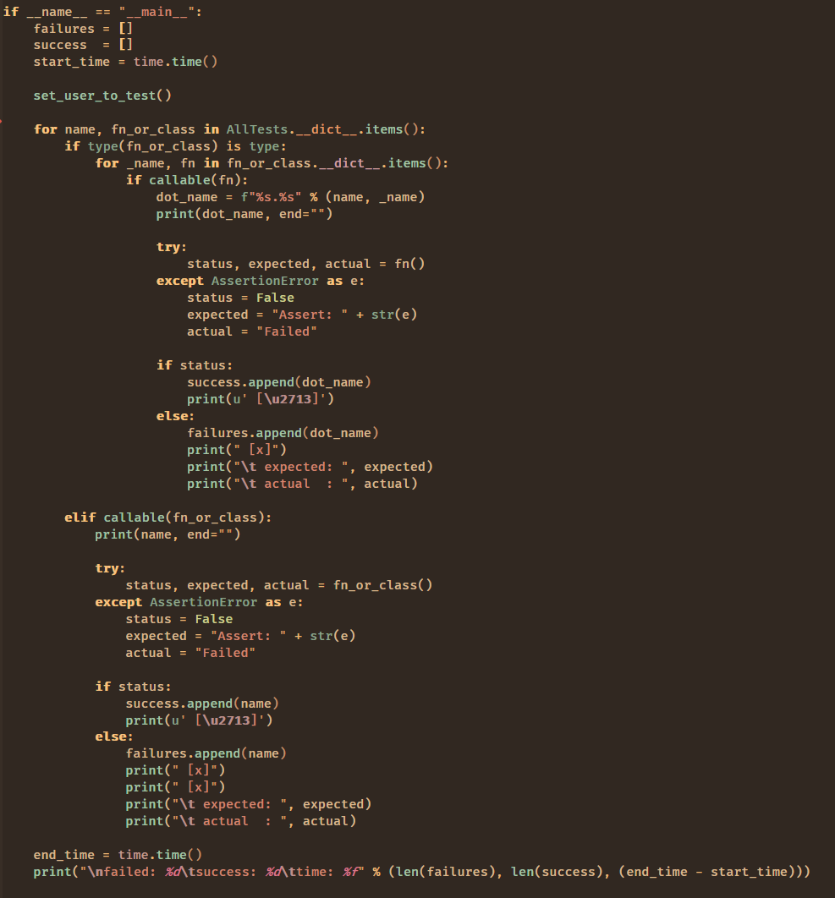
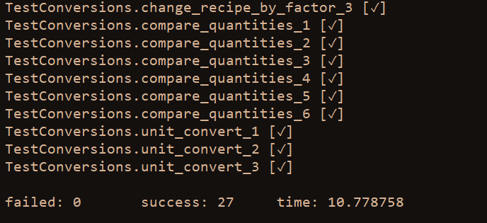
Testing
Custom test framework
  Simple implementation
  Handles assertions
  Handles UI testing
Focused on “code coverage”
  Test every database function
  Test every button / input

Slide 5
Demo

Slide 6
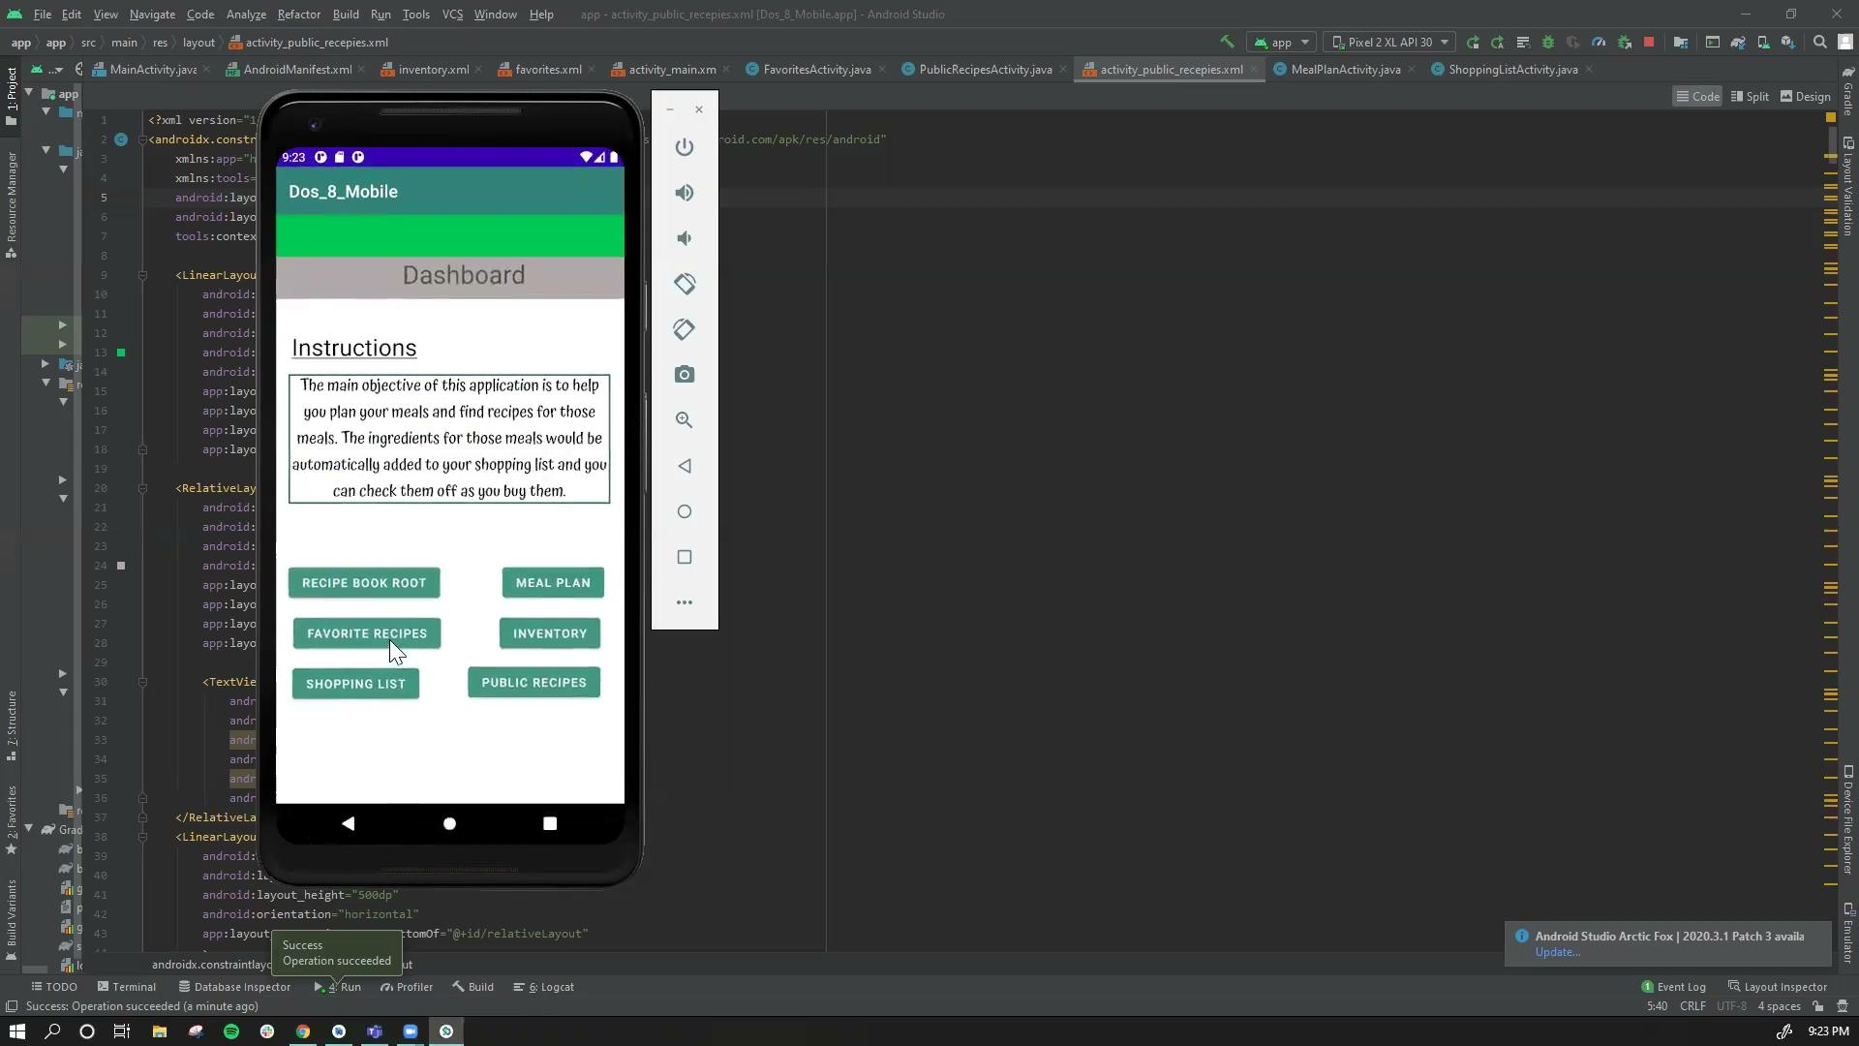
Mobile App

Slide 7
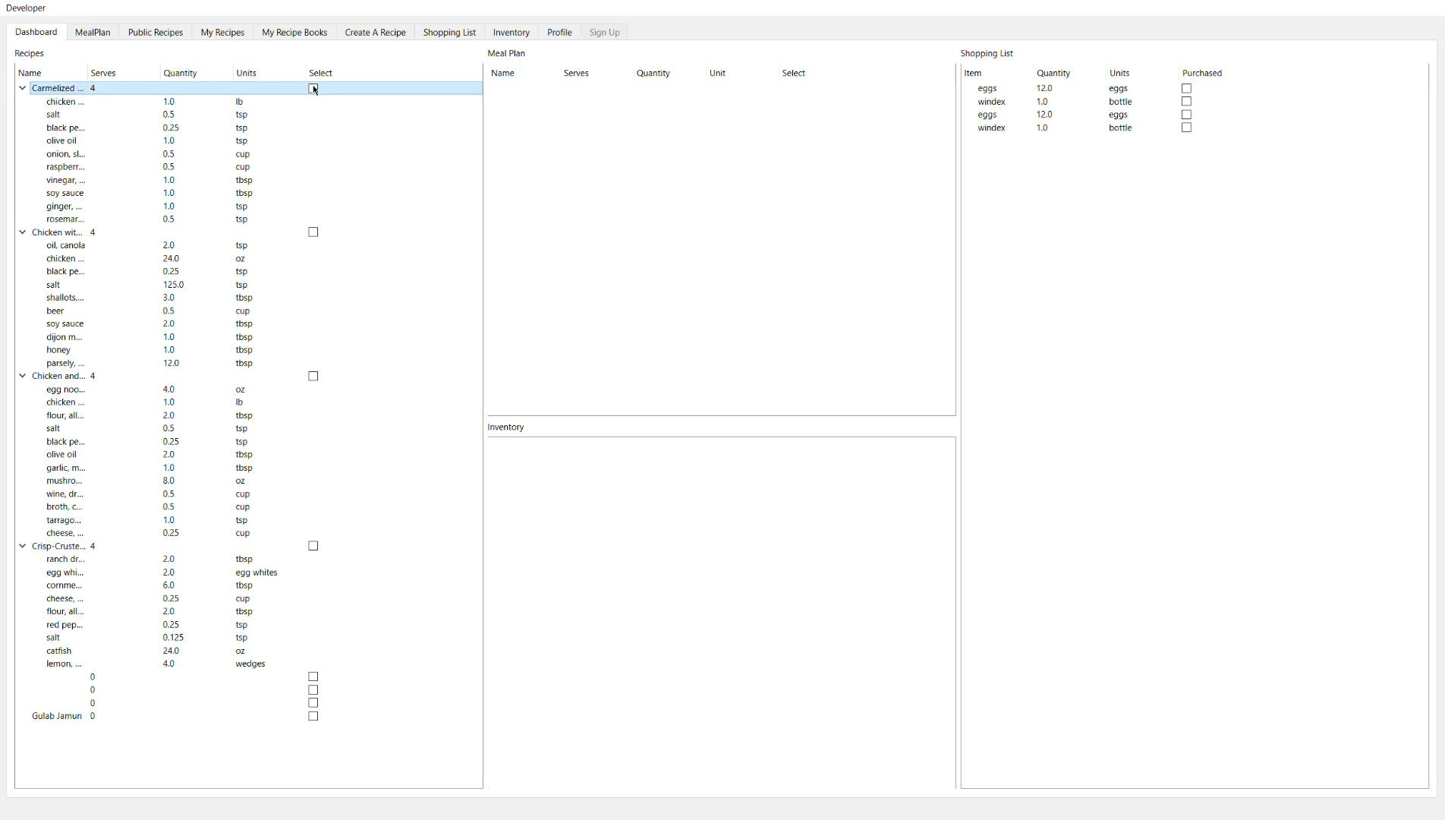
Dashboard
Contains small views of common pages
Easy to get a glance of all the information at once

Slide 8
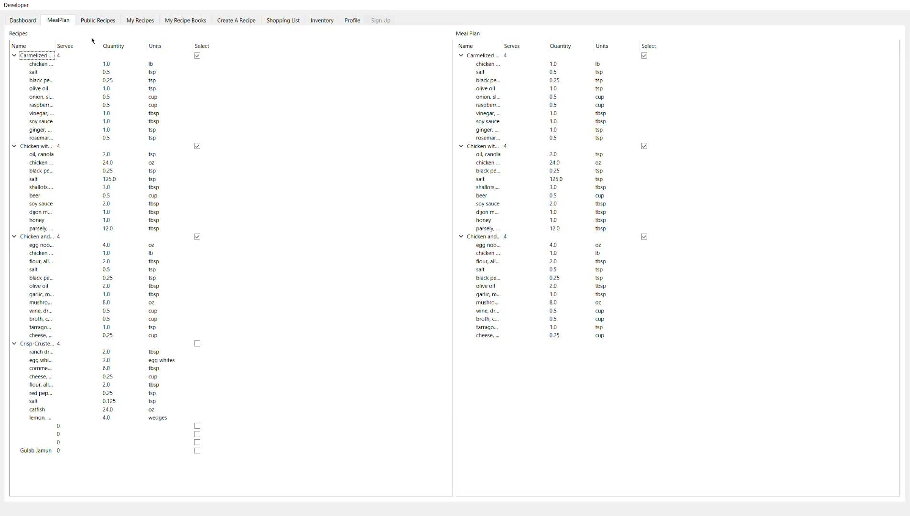
Meal Plan
A view of just the recipes that you can view (public and your own private recipes).
A view of the selected recipes that you want to shop for.

Slide 9

Public Recipes
A list of all public recipes
Add recipes to meal plan

Slide 10
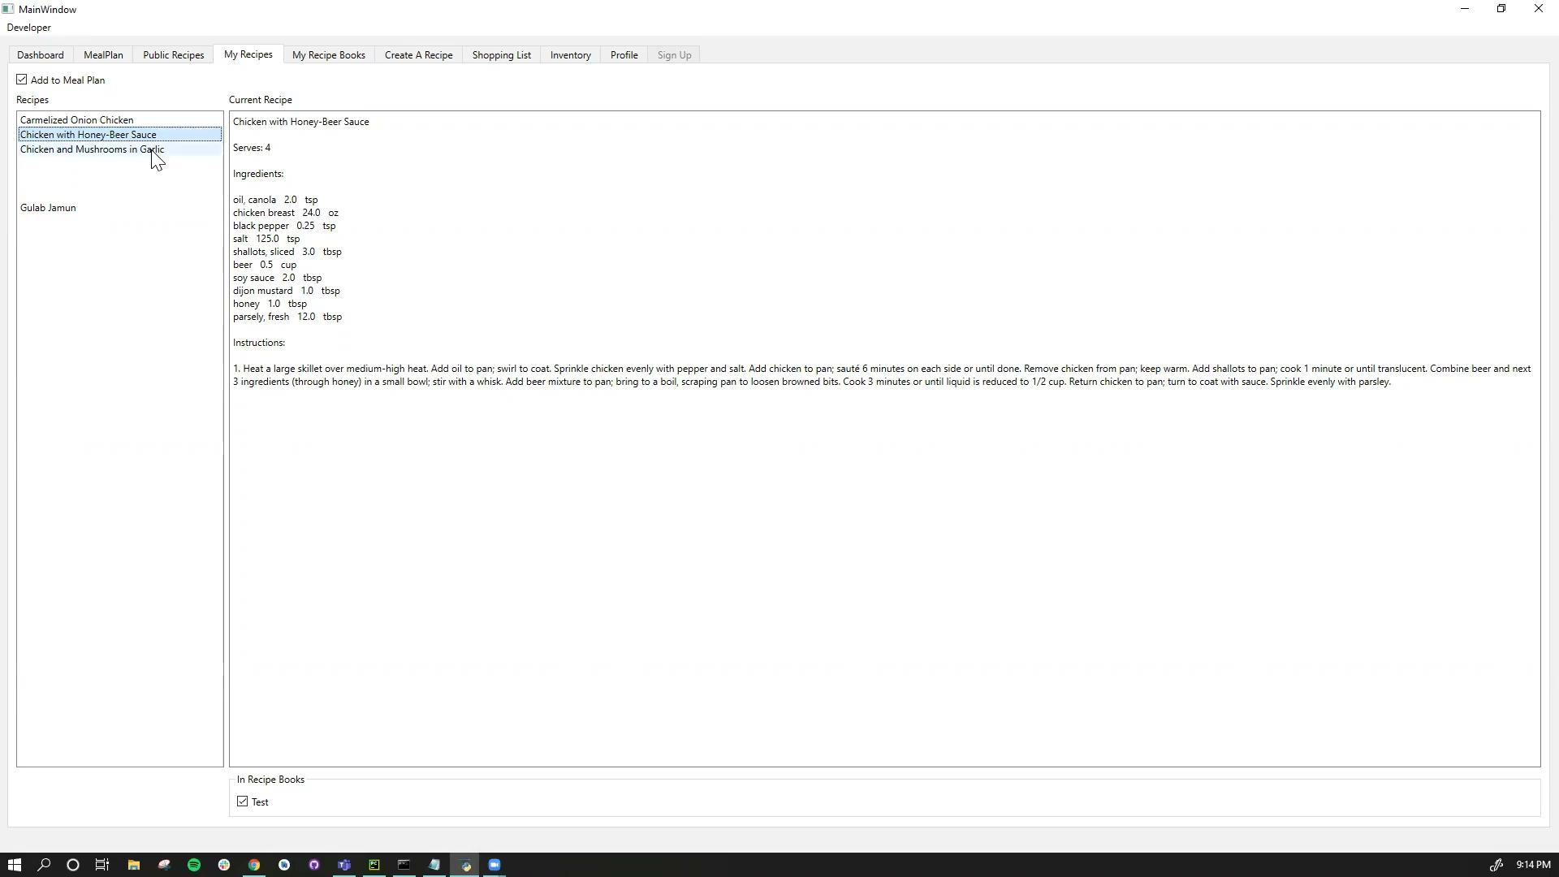
My Recipes
- Check your recipes
- Add the recipes to your meal plan

Slide 11
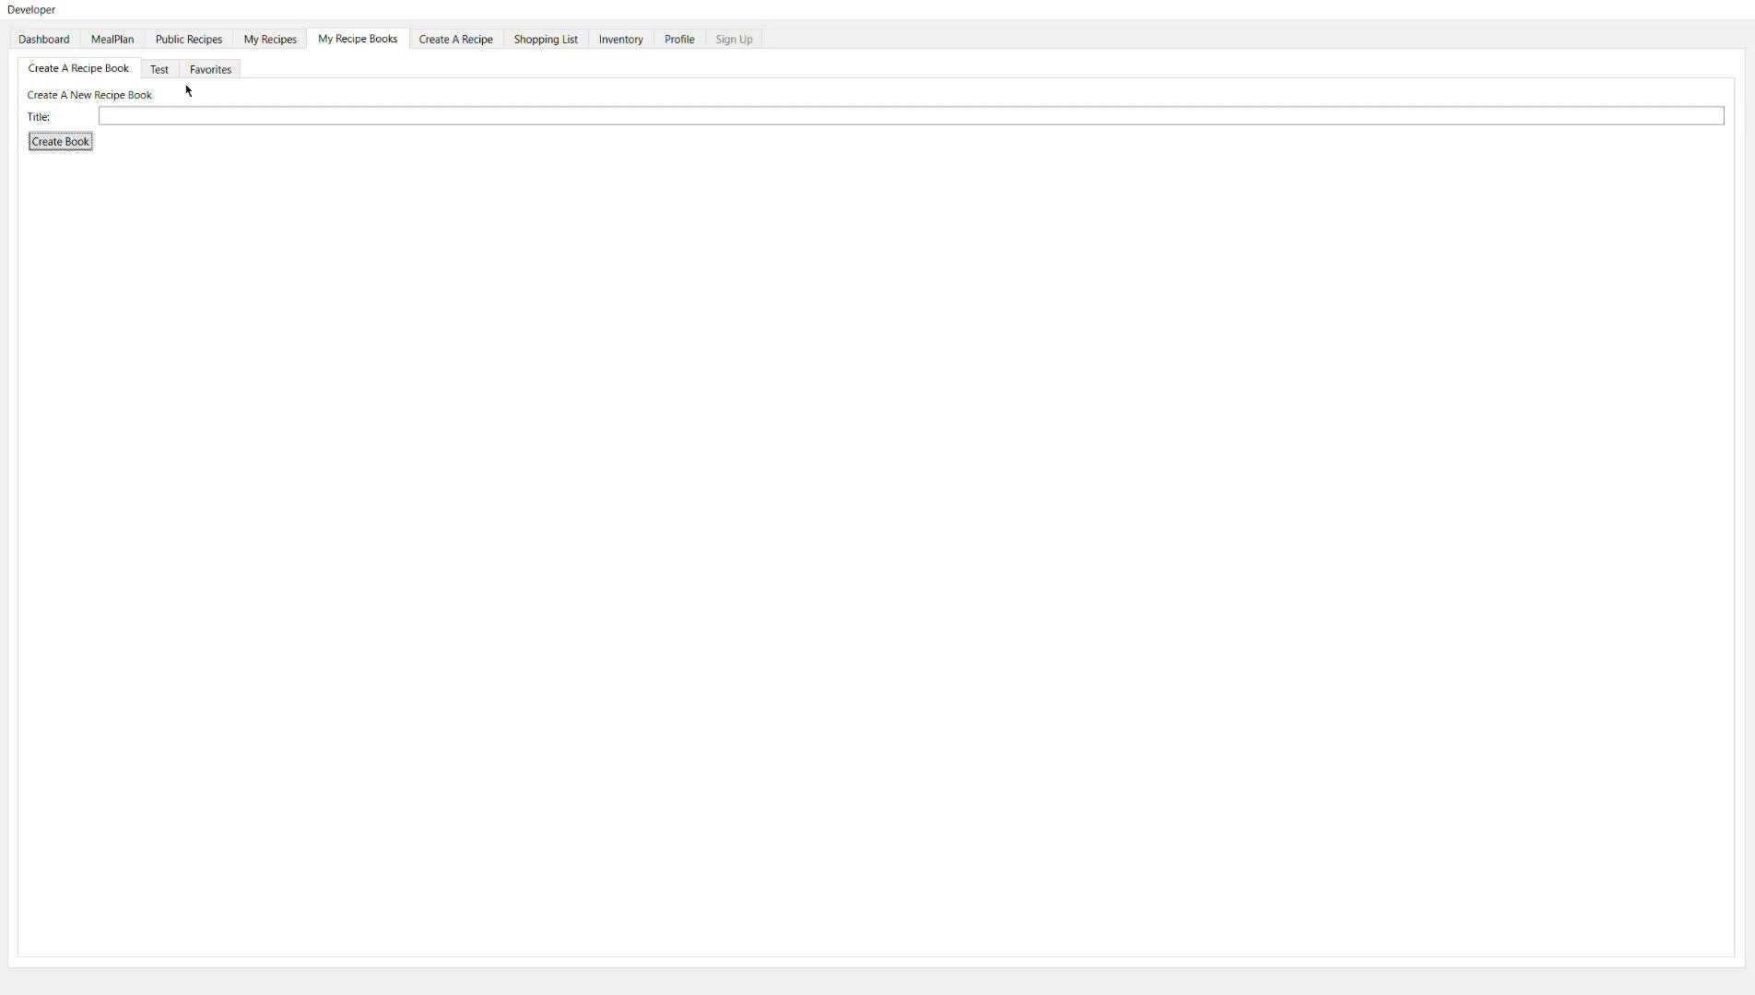
My Recipe Books
This is a browser for all user-created recipe books.

Slide 12
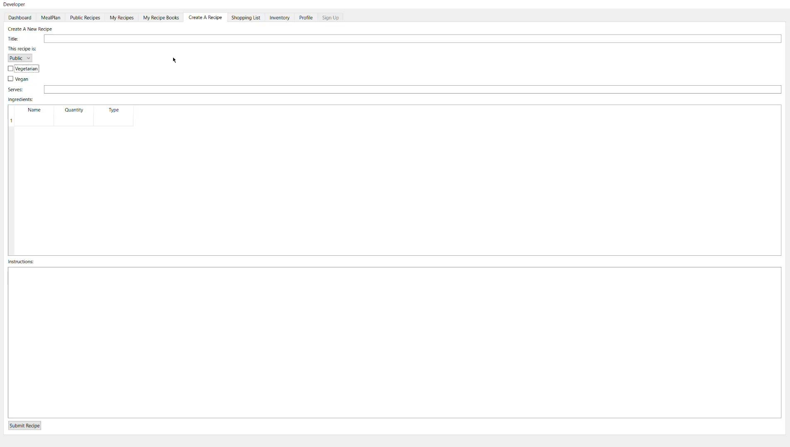
Create A Recipe
Form for adding a recipe to the system.

Slide 13
Shopping List
Generated from the meal plan

Slide 14
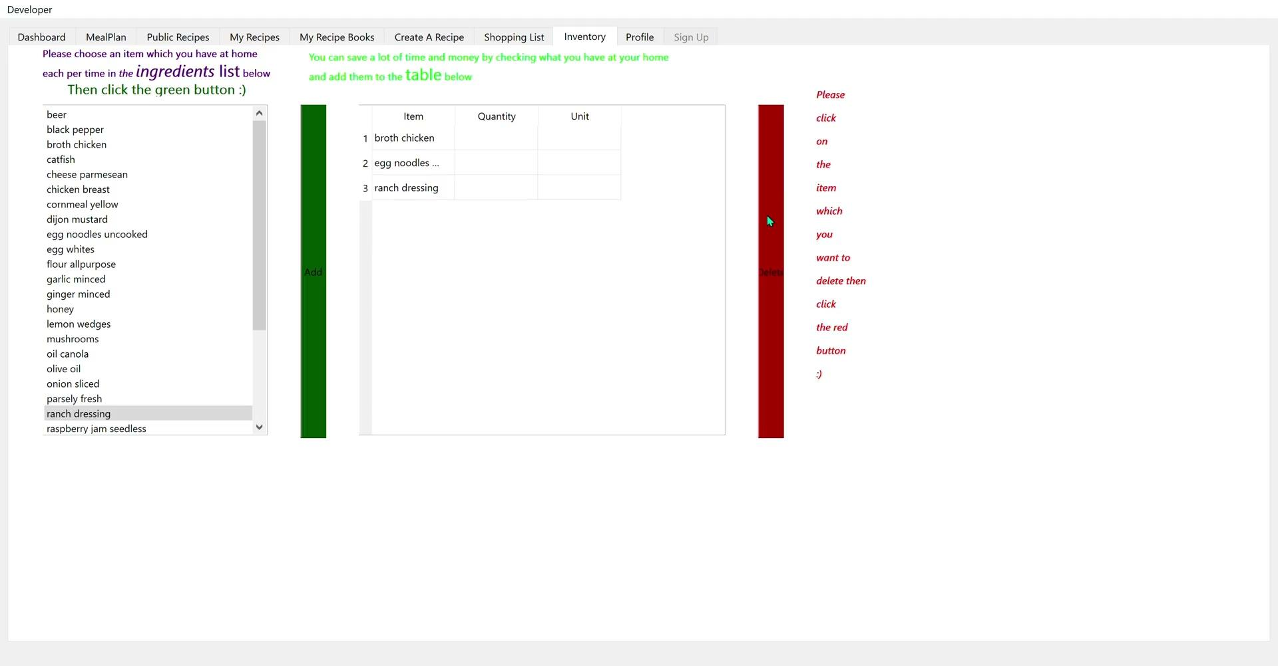
The Inventory
Users fills out what they have at their home.

Slide 15
Profile
Allows the user to log in.

Slide 16

Sign Up
Allows user to sign in
Disables functional tabs if not signed in
Disables login tab when signed in

